Slide 1

March Madness Case Completion: Bracketology
Team Slam Dunk
Hong Dai; Hsin-Yun (Celia) Hsieh;
Xiao Li, Heng-Ching (Hank) Lin

Slide 2

Summary
1
Objective:
Establishing models with 2003 to 2016 game data to (1) predict 2017 match outcomes
and (2) minimize log loss.
I. Final Model: The weighted combination of two nominal logistic classifiers yields the lowest
log loss
II. Log loss: a metric measures the accuracy of a classifier. The loss function quantifies the
amount by which the prediction deviates from the actual value. Our lowest log loss of final
model is 0.5237
Prediction summary of 2017 games
I. First round: 90.60% (29/32)
II. Sweet 16: 83.33% (40/48)
III. Predicted Champion: Gonzaga Bulldogs
Robust model
I. High accuracy and optimized log loss
II. Adopting Integrated variables can explain most cases and decrease the number of variables

Slide 3
Analysis Process
2
Data Collection
Data Preprocessing
Model Building
(2 Models)
Model Combination
Final evaluation
Data cleaning
Data merging
Variable selection
Weight Model 1 and Model 2:
Final Model
Accuracy
Champion Probability
Average winning probability
Box score data fetching
Variable Difference
calculation
Model selection
Model optimization for Model 1
Point Spread data collection
Model 2 building
* Point Spread is a forecast of the number of points by which stronger team is expected to defeat a weaker one, is used for betting purposes.

Slide 4
Data Description
3
Data of MODEL 1
Dataset 1: original data
Dataset 2: average box score of each team during regular seasons (2003 to 2016)
Advanced dataset: four factors have no collinearity and explain team success.
Final dataset: variable difference that takes two competing teams’ performance into account
Step 1:
Dataset 1
Step 2:
Dataset 2
Step 3:
Advanced dataset
(merging dataset 1 and 2 and calculating the following)
Step 4:
Final dataset
(calculated from advanced dataset)
915 game records from March Madness Tournament 2003 to 2016 (training set))
Average team box score during regular seasons from 2003 to 2006
Effective Field Goal Percentage (EFG)
Turnover Committed per Possession (TPP)
Offensive Rebounding Percentage (ORP)
Free Throw Rate (FTR)
Variable difference
Examples: seed_difference, distance_difference
Data of MODEL 2
Dataset: 89,013 regular season and March Madness tournament games with available Point Spread
Notes:
- Final variables are the difference of team 1 and team 2’s performance (e.g. seed_difference, distance_difference), so we can take the 2 competing teams into account.
- Effective Field Goal Percentage = (all field goal made + 0.5 (3-point field goals made) / (all field goal attempts))

Slide 5
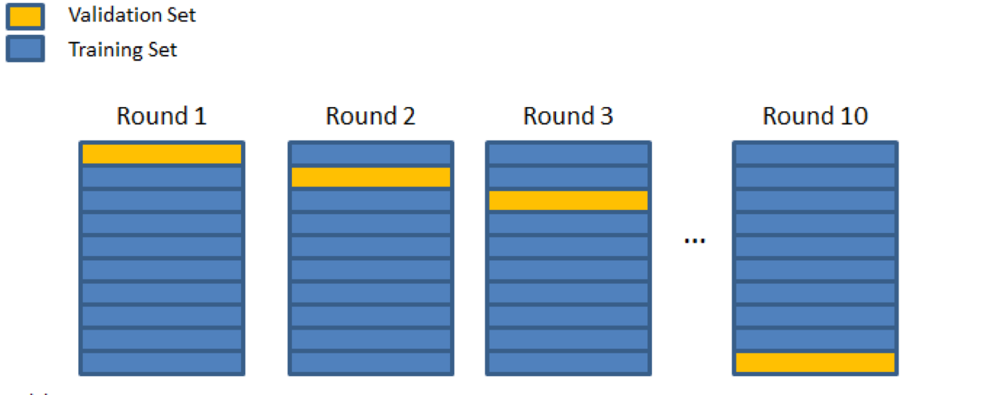
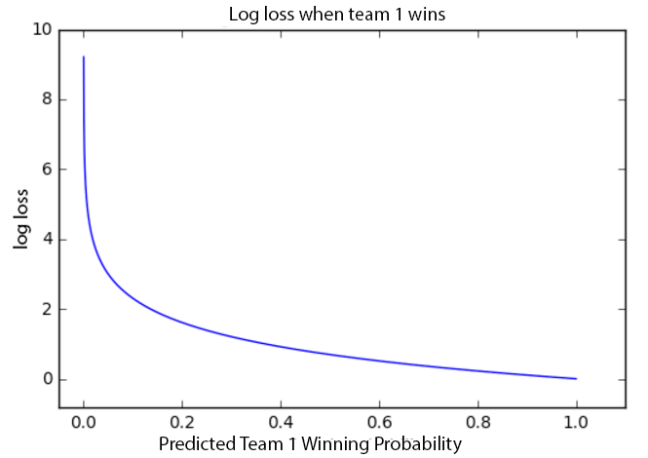
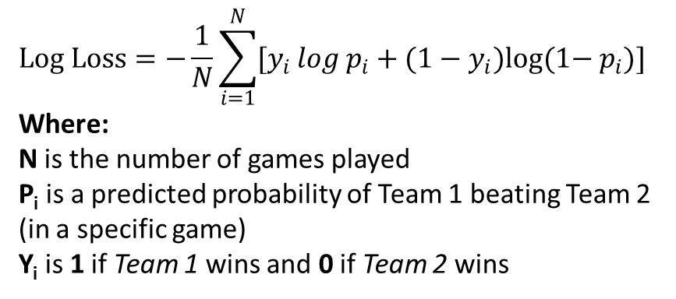
Terminologies
4
Log Loss
K Folds ( K = 10)
$$Log Loss=−\frac{1}{N}\sum_{i=1}^{N}{[y_{i }log{ p}_{i}+(1−y_{i})log(1−{ p}_{i})]}$$
Where:
N is the number of games played
P_{i} is a predicted probability of Team 1 beating Team 2 (in a specific game)
Y_{i} is 1 if Team 1 wins and 0 if Team 2 wins
K Fold is a model validation technique for assessing how the results of a statistical analysis will generalize to an independent data set.
The data set was divided into 10 equal partitions. In Nth iteration, the Nth fold became Validation Set while the remaining 9 folds were Training Set.

Slide 6
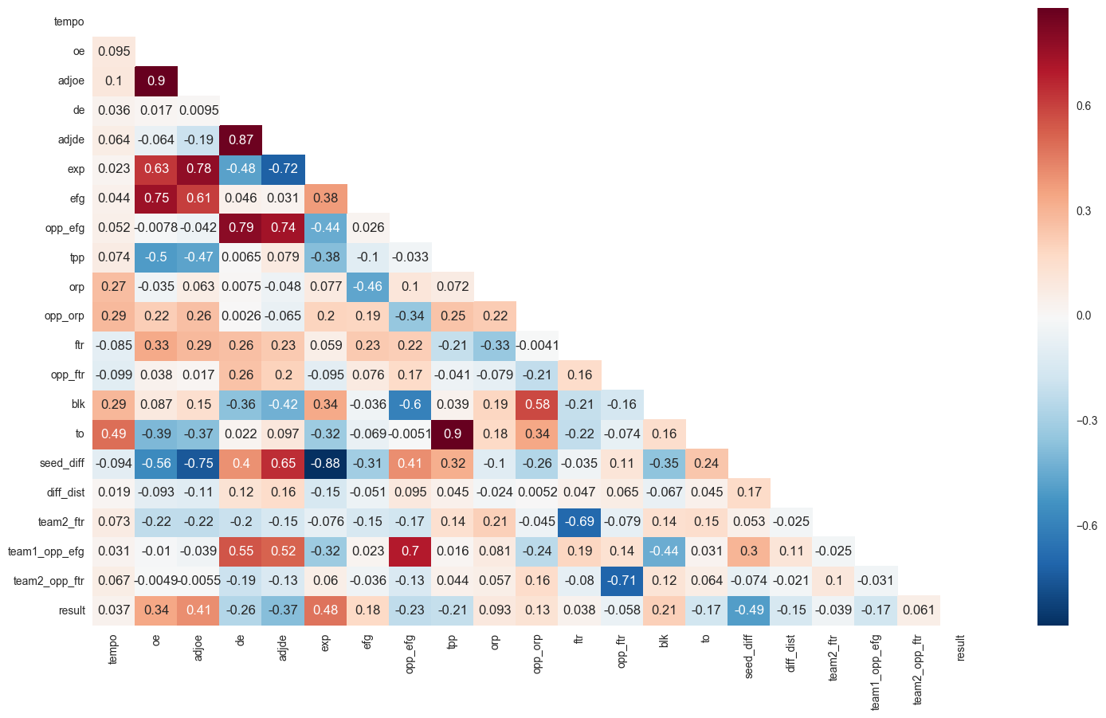
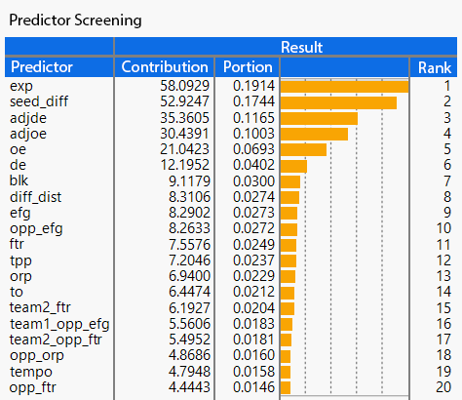
Variable Selection
5
Feature selection - Use bootstrap forest partitioning to evaluate the contribution of predictors on the response (Cut from 161 variables to 20 variables).
Remove variables with high correlation (>0.7) (Cut from 20 variables to 16 variables).
Remove one out of two highly related variables, e.g. Keep adjde, adjoe; Remove de, oe. (The darker the color, the higher the correlation. )
Notes:
Adjoe: adjusted offense efficiency
Adjde: adjusted defense efficiency
oe – Points scored per 100 offensive possessions.
de – Points allowed per 100 defensive possessions.

Slide 7
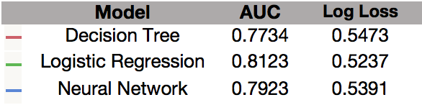
Model Selection
6
Three different statistics/analytics tools were used to build the model:
Decision tree
Nominal Logistic Regression
Neural Network
Receiver operating characteristic curves (ROC) were used to determine the best tools for our model*
Nominal Logistic Regression has slight edge over other statistics/analytics tools in this case
We use Nominal Logistic Regression to build our model
*ROC curve, is a graphical plot that illustrates the performance of a binary classifier system.

Slide 8
Model Optimization
7
Example Variable Combinations | Log Loss | STD Log Loss* | Accuracy*
dist_diff, adjoe, adjde, efg, orp, tpp, ftr, opp_ftr** | 0.5273 | 0.0411 | 0.726
dist_diff, adjoe, adjde, efg, orp, tpp, ftr, seed_diff** | 0.5287 | 0.0442 | 0.718
Dist_diff, tempo, efg, opp_efg, tpp, orp, opp_orp, opp_ftr** | 0.5849 | 0.0185 | 0.6191
Chosen model
Different combinations of models with variable number range from 6-16 yields more than nominal logistic regression 100,000 models
Model log loss ranges from 0.5245 to 0.6894
Nominal Logistic Regression with 8 or 9 variables result in low Log Loss and high accuracy without the risk of overfitting
Choose the model with low Log Loss, high accuracy, and great stability
* Standard deviation of Log Loss and average accuracy of 10 models generated using K-Fold
**All variables are differences team1 – team2
Notes:
Dist_diff: difference of distance from team1 and team2 from the neutral site where the game take place
Adjoe: adjusted offense efficiency
Adjde: adjusted defense efficiency
Efg: effective field goal percentage
Orp: Offensive rebound percentage
Tpp: turnover per possession
Ftr: free throw rate
Opp_ftr: opponent free throw rate
Seed_diff: seed difference between team1 and team2
Tempo: tempo difference between team1 and team2

Slide 9
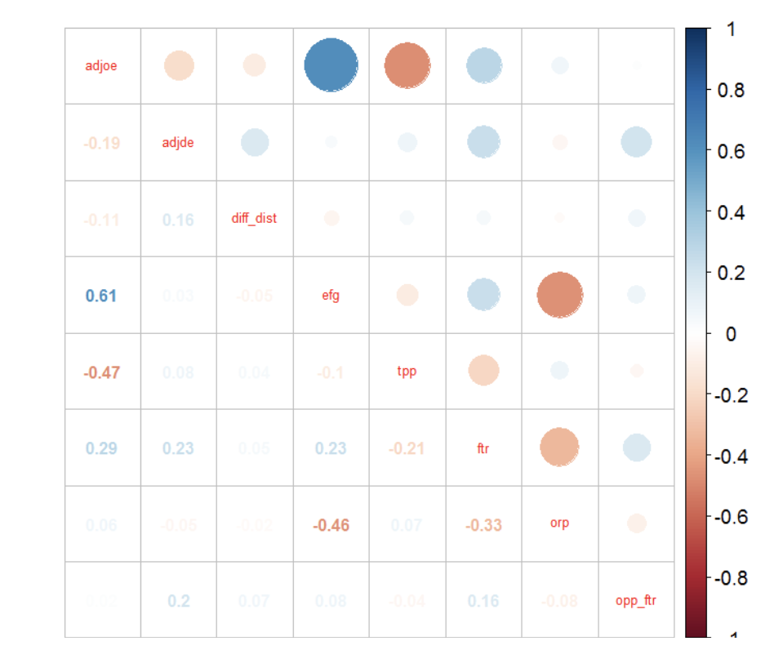
Model Optimization - cont’d
8
“The Right Way to Apply K-Fold Cross Validation”
Find the best model within the 10 models generated by K-Fold Cross Validation, and use the corresponding coefficients of regression line to build model
The 4th K-Fold generated model has Log Loss of 0.5054, and the coefficients are used for our final model building
N^{th} iteration | Log Loss
1 | 0.513076
2 | 0.530693
3 | 0.523824
4 | 0.505439
5 | 0.523007
6 | 0.53161
7 | 0.527918
8 | 0.513609
9 | 0.526384
10 | 0.520907
Make sure there is no strong collinearity between selected variables (No correlation coefficient larger than 0.7 among variables)

Slide 10
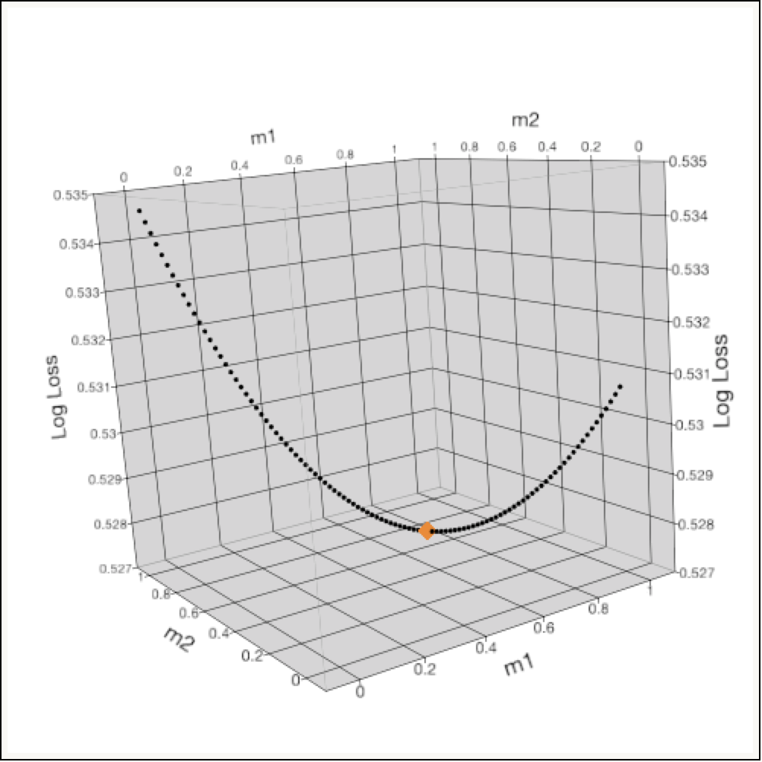
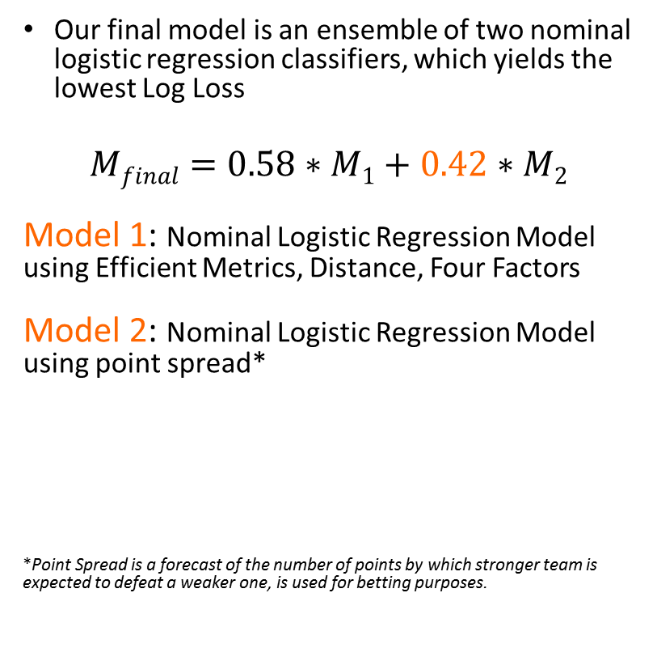
Final Model
9
Our final model is an ensemble of two nominal logistic regression classifiers, which yields the lowest Log Loss
$$Mfinal=0.58∗M1+0.42∗M2$$
Model 1: Nominal Logistic Regression Model using Efficient Metrics, Distance, Four Factors
Model 2: Nominal Logistic Regression Model using point spread*
*Point Spread is a forecast of the number of points by which stronger team is expected to defeat a weaker one, is used for betting purposes.
Notes:
-Our model is an ensemble of two nominal logistic regression classifiers, in which individually produced classifier are merged via a weighted average (Opitz and Maclin, 1999)
-Previous work has shown that ensemble methods work best using accurate classifiers which make errors in different input regions, because areas where one classifier struggles would be offset by other classifiers ( Hansen and Salamon, 1990 ).

Slide 11
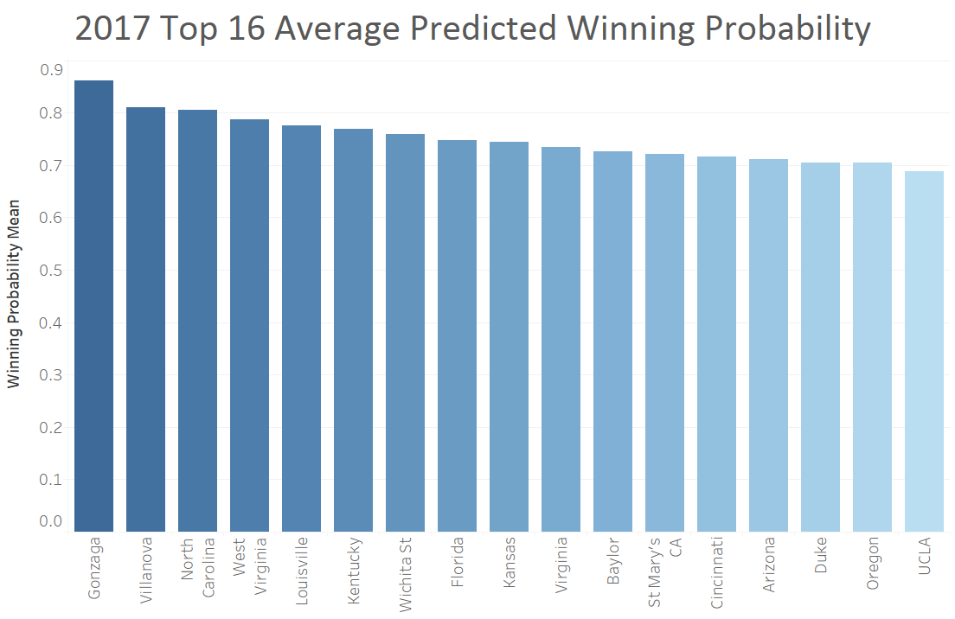
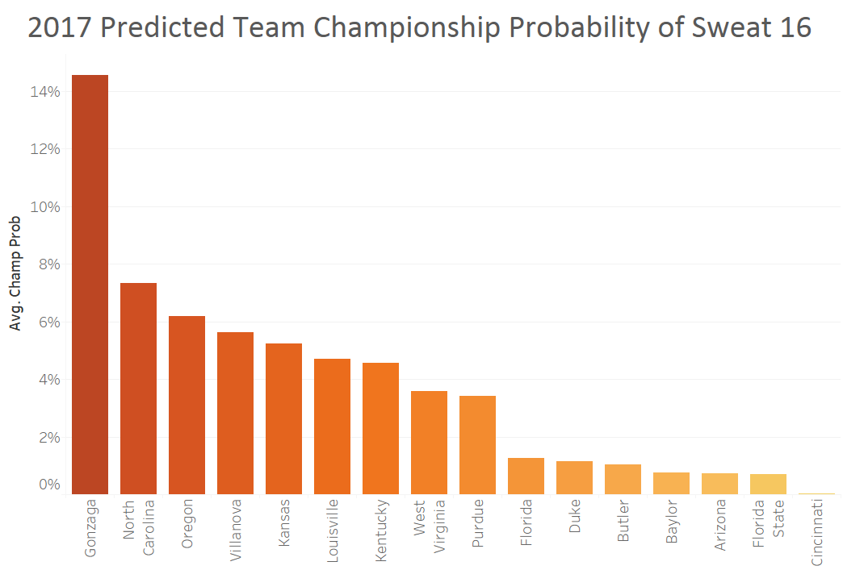
Predicted Average Winning + Championship Probability
10
Teams are ranked by average winning probability against all possible matchups, the top 4 teams are Gonzaga, Villanova, North Caroline and West Virginia.
Gonzaga is the most favored team to win the championship (14.56%), followed by North Carolina (7.32%), Oregon (6.2%) and Villanova (5.62%).

Slide 12
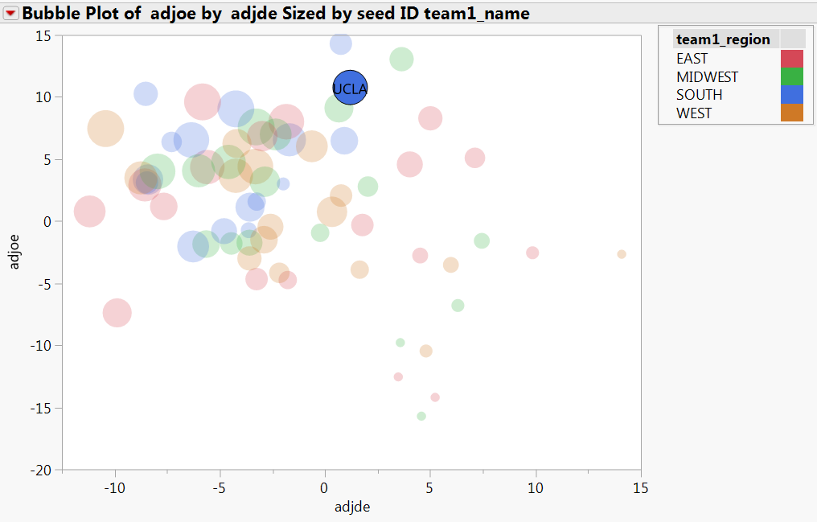
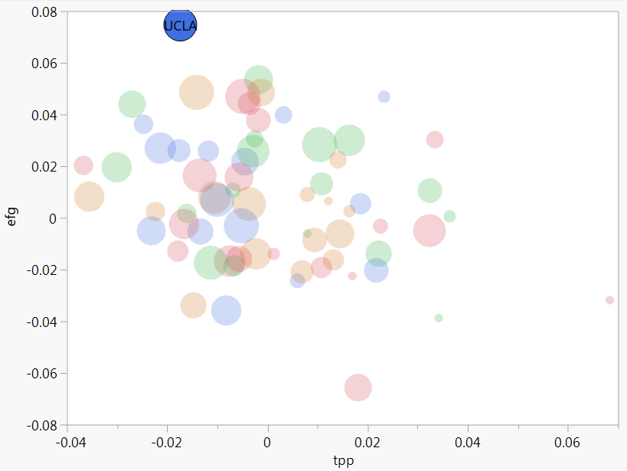
An interesting insight - UCLA
11
UCLA was not predicted as Sweet 16 in our model, but there are some interesting insight for UCLA games.
Compared to other teams with higher ranking seed, UCLA has:
I. higher difference of offensive and defensive efficiency
II. higher difference of effective field goal and lower difference of turnover per possession
Possible reason: UCLA belongs to South region, the most competitive region, leading to lower predicted winning probability.

Slide 13
Conclusion
12
(1) 4 factors, (2) Distance, (3) Adjusted Offense Efficiency and (4) Adjusted Defense Efficiency are important variables for predicting winning probability.
Point spread with weighted combination model can decrease log loss efficiently by predicting upset match. (e.g. Middle Tennessee State (#12) beat Minnesota (#5) with lower seed rank)
Prediction summary of 2017
First round: 90.60% (29/32)
Sweet 16: 83.33% (40/48)
Predicted Champion: Gonzaga Bulldogs

Slide 14
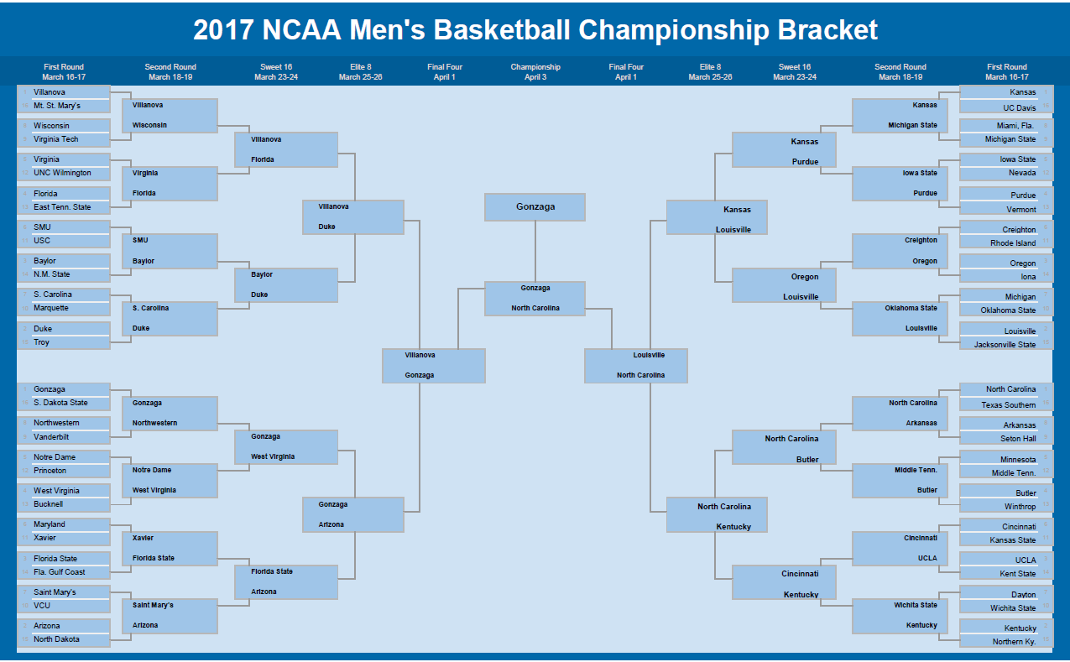
Appendix 1 – Predicted Brackets
13

